Slide 1
Financial Aid 101 De-Mystifying the Process
John Iacovelli
College Quest Now (CQN)
Dean of Enrollment
“emeritus”

Slide 2
The Mission
The Higher Education Student Assistance Authority is the only State agency with the sole mission of providing students and families with the financial and informational resources to pursue their education beyond high school.

Slide 3
Goal of Financial Aid
Primary goal is to assist students in paying for college and is achieved by:
Evaluating family’s ability to pay for educational costs
Distributing limited resources in an equitable manner
Providing a balance of gift aid and self-help aid

Slide 4
Sources of Aid
Federal
State
The University/College
Private
Civic organizations (i.e., local Rotary Club, parent’s employer, high school awards, etc.)

Slide 5
Types of Financial Aid
Scholarships
Grants
Loans
Employment Opportunities

Slide 6
Merit-Based Aid vs. Need-Based Aid
Merit-Based Aid - aid given to students strictly on the basis of merit. May be based on:
Academic record
Special characteristics
Skills or talents
Involvement
Does not have to be repaid; may be renewable from year to year.
Need-Based Aid - aid awarded to students on the basis of financial need. Re-evaluated each year as financial situations may change.

Slide 7
Federal and State Grants & Scholarships
Federal
PELL
SEOG (Supplemental Educational Opportunity Grant)
State
TAG (Tuition Aid Grant) – part time for county college
EOF (Educational Opportunity Fund)
GUS (Governor’s Urban Scholarship)
GIVS (Governor’s Industry Vocations Scholarship)
STARS I & II (Student Tuition Assistance Reward Scholarship)
Institutional
Private Scholarships and loans

Slide 8
Community College Opportunity Grant (CCOG)
Students enrolled at least half – time (6 credits) whose household AGI does not exceed $65,000 are eligible for free tuition and approved fees at all county colleges.
Atlantic Cape Community College
Bergen Community College
Camden County College
Cumberland County College
Hudson County Community College
Mercer County Community College
Middlesex County College
Burlington Community College
Gloucester County College
Sussex County Community College
Ocean County College
Passaic County Community College
Rowan College at Gloucester County
Salem Community College
Union County College
Warren County Community College
Brookdale Community College
Essex County College
County College of Morris
Raritan Valley Community College

Slide 9
Loans
Federal Direct Loan Program
Subsidized Loan (4.53%)
Unsubsidized Loan (4.53%)
PLUS (7.08%)
Loan Limits:
First-year students – $5,500 ($3,500 can be subsidized)
Second-year student – $6,500 ($4,500 can be subsidized)
All other grade levels remain at -$7,500 ($5,500 can be subsidized)
Independent students whose parents are unable to obtain PLUS loans can receive additional unsubsidized loan money

Slide 10
NJ Class Loan
NJ Class Supplemental Loan Program
Low fixed interest rates beginning with:
10 Year Repayment Loan of 3.99%
Immediate Repayment of Principal & Interest Only
15 Year Repayment Loan(s) of 4.49%
Interest only payments while in school
20 Year Repayment Loan of 6.50%
Full deferment while enrolled at least half time in school

Slide 11
Application Process
Submit the Free Application for Federal Student Aid (FAFSA) prior to the college’s deadline
Early FAFSA: Apply as early as October 1st
To ensure maximum consideration for federal, state, and institutional aid, check information from each college to determine:
Required application materials
Application deadlines

Slide 12
Free Application for Student Aid (FAFSA)
FAFSA on the Web at www.fafsa.gov
New federal regulation: Prior Prior Year (PPY) Students can begin the FAFSA process starting October 1st using 2018 taxes
Now available on mobile phone and tablet
FSA ID – sign FAFSA electronically for faster Processing

Slide 13
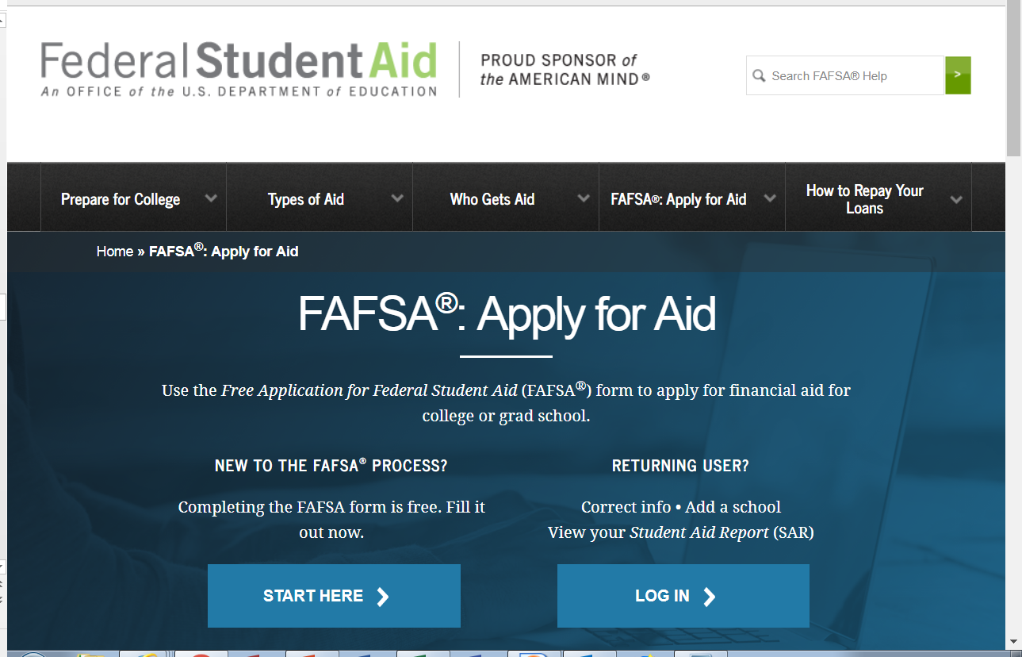
A FAFSA Must Be Filed on the Web

Slide 14
Common Mistakes Made on the FAFSA
Correct name, social security # and birth date
Number of people in the household
Divorced/remarried households
Parental and student assets
Worth of a second home or portion rented
“Zero is a number” Please note: Using the FAFSA’s Data Retrieval Tool (DRT) can help families avoid simple mistakes while completing the FAFSA.

Slide 15
Definition of Need
Cost of Attendance (COA)
– Expected Family Contribution (EFC)
= Financial Need

Slide 16
What is EFC?
Basis of financial aid package
EFC is determined by a federal formula that calculates need via the FAFSA
EFC & Financial Need are guidelines used by schools to determine a financial aid package
EFC not necessarily equal to the out-of-pocket cost of the family

Slide 17
Cost of Attendance
Tuition and fees
Room and board
Books and supplies, equipment, transportation, and miscellaneous personal expenses
Study abroad costs
Dependent care expenses
Expenses related to a disability
Expenses for cooperative education program

Slide 18
Need Varies Based on Cost
1
X
2
Y
3
Z
EFC
EFC
Cost of
Attendance
(Variable)
Expected Family
Contribution
(Constant)
Need
(Variable)

Slide 19
New Jersey Alternative Financial Aid Application
The New Jersey Alternative Financial Aid Application allows NJ Dreamers enrolled in eligible New Jersey colleges and universities to apply for state financial aid.
Who should complete this application?
Complete this application if you are not a United States citizen or eligible noncitizen and meet all of the following criteria;
Attended a New Jersey high school for at least three (3) years
Graduated from a New Jersey high school or received the equivalent of a high school diploma in New Jersey
Registered for Selective Service (male students only)
Are able to file an affidavit stating that you have filed an application to legalize your immigration status or will file an application as soon you are eligible to do so

Slide 20
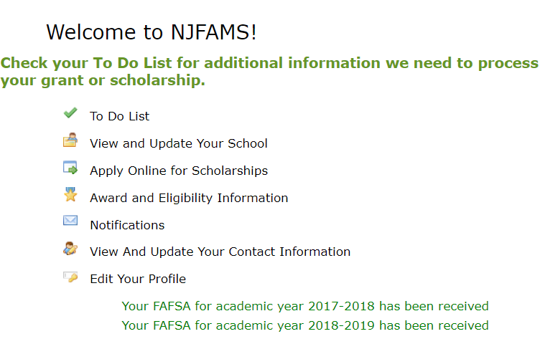
NJFAMS

Slide 21
The Cycle of Financial Aid
Oct-March
Student /Parents complete FAFSA
Nov-May
School sends award letter
June-July
School sends Fall semester bill

Slide 22
HESAA and Federal Student Aid Services
HESAA Web Sites
www.hesaa.org
www.njgrants.org
www.njclass.org
https://njfams.hesaa.org
HESAA Financial Aid Hotline
609 – 584 – 4480 (English & Spanish)
8:00 am – 8:00 pm Monday thru Thursday
8:00 am – 5:00 pm Friday
NJBEST – College Savings Plan www.njbest.org
Federal Aid Website and Toll-free Number www.studentaid.ed.gov 1-800-433-3243 or studentaid@ed.gov

Slide 23
Additional Resources
Net Price Calculator (each institutional website)
www.collegescorecard.ed.gov
www.fafsa.gov
www.finaid.org
www.fastweb.com
www.mappingyourfuture.org
www.collegeboard.org

Slide 24
Student Loan Debt = $1.4 TRILLION

